Slide 1
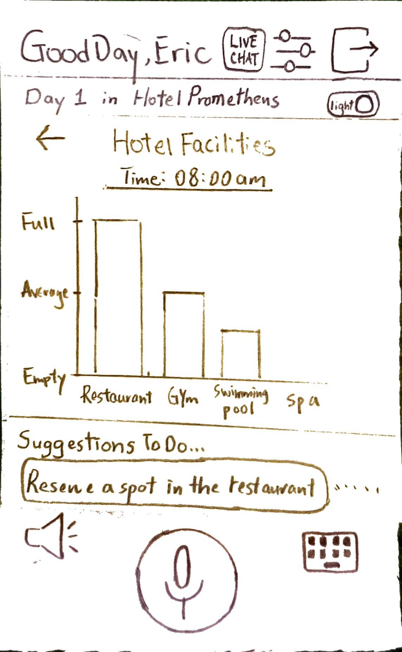
Hotel Usage Page

Slide 2
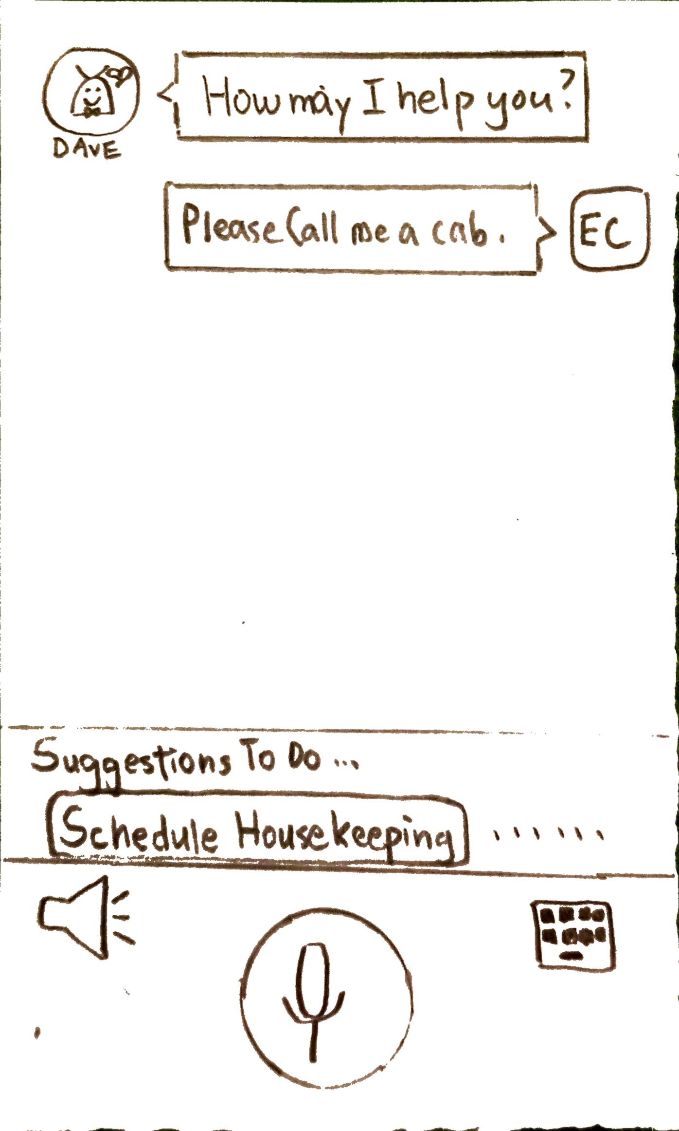
Request Page
Please reserve a spot at the restaurant.
Ok!
Make Reservation

